Slide 1
ARMADA
By Elisha ESH
A Military Strategy Game

Slide 2
-01-
Purpose
{C|
M&$1.
"XB$$8|
.z$$$$o
fh$$$$$}
{f. Q8 _@$$$$$j.
~%n 'j$$$$$$$$$8j
]M$t L$$$$$$$$$x
!o$$_ .X$$$$$$$$$$$w
'@$$$$$$$$$$$$$$@f``''`'|$$$$$$$$$$$$%
lq$$$$$$$$$$$$$$$$$$$$$$$$$$$$$$$$$$Bb_
^0$$$$$$$$$$$$$$$$$$$$$$$$$$$$$$$$$$$/'
l "!#$$$$$$$$$$$$$$$$$$$$$$$$$$$$$$t.
}8$$$$$$$$$$$$$$$$$$$$$$$$$$x
(C@$$$$$$$$$$$$$$$$$$$$$$$n
r%$$$$$$$$$$$$$$$$$$$$$x
^q$$$$$$$$$$$$$$$$$$$o~
I8$$$$$$$$$$$$$$$$$$$[
?ftfffJ$$$$$$$$$$$$$$$$$$$$$$$$$]
r$$$$$$$$$$$$$$$$$O$$$$$$$$$$$$$$[
'`-$$$$$$$$$$$v. ,$$$$$$$$$$$$$$: +
>@$$$$$$$u io$$$$$$$$$$$$; ^+mk
b$Wm$$$$8| [W$$$$$$$$$$z@$di
c$$$O >@$$$$$$$$$$8i
w$$Z ]$$$$$$$B;
c@$O -*$$$M{
|( >a$)
r}.
{C|
M&$1.
"XB$$8|
.z$$$$o
fh$$$$$}
{f. Q8 _@$$$$$j.
~%n 'j$$$$$$$$$8j
]M$t L$$$$$$$$$x
!o$$_ .X$$$$$$$$$$$w
'@$$$$$$$$$$$$$$@f``''`'|$$$$$$$$$$$$%
lq$$$$$$$$$$$$$$$$$$$$$$$$$$$$$$$$$$Bb_
^0$$$$$$$$$$$$$$$$$$$$$$$$$$$$$$$$$$$/'
l "!#$$$$$$$$$$$$$$$$$$$$$$$$$$$$$$t.
}8$$$$$$$$$$$$$$$$$$$$$$$$$$x
(C@$$$$$$$$$$$$$$$$$$$$$$$n
r%$$$$$$$$$$$$$$$$$$$$$x
^q$$$$$$$$$$$$$$$$$$$o~
I8$$$$$$$$$$$$$$$$$$$[
?ftfffJ$$$$$$$$$$$$$$$$$$$$$$$$$]
r$$$$$$$$$$$$$$$$$O$$$$$$$$$$$$$$[
'`-$$$$$$$$$$$v. ,$$$$$$$$$$$$$$: +
>@$$$$$$$u io$$$$$$$$$$$$; ^+mk
b$Wm$$$$8| [W$$$$$$$$$$z@$di
c$$$O >@$$$$$$$$$$8i
w$$Z ]$$$$$$$B;
c@$O -*$$$M{
|( >a$)
r}.
{C|
M&$1.
"XB$$8|
.z$$$$o
fh$$$$$}
{f. Q8 _@$$$$$j.
~%n 'j$$$$$$$$$8j
]M$t L$$$$$$$$$x
!o$$_ .X$$$$$$$$$$$w
'@$$$$$$$$$$$$$$@f``''`'|$$$$$$$$$$$$%
lq$$$$$$$$$$$$$$$$$$$$$$$$$$$$$$$$$$Bb_
^0$$$$$$$$$$$$$$$$$$$$$$$$$$$$$$$$$$$/'
l "!#$$$$$$$$$$$$$$$$$$$$$$$$$$$$$$t.
}8$$$$$$$$$$$$$$$$$$$$$$$$$$x
(C@$$$$$$$$$$$$$$$$$$$$$$$n
r%$$$$$$$$$$$$$$$$$$$$$x
^q$$$$$$$$$$$$$$$$$$$o~
I8$$$$$$$$$$$$$$$$$$$[
?ftfffJ$$$$$$$$$$$$$$$$$$$$$$$$$]
r$$$$$$$$$$$$$$$$$O$$$$$$$$$$$$$$[
'`-$$$$$$$$$$$v. ,$$$$$$$$$$$$$$: +
>@$$$$$$$u io$$$$$$$$$$$$; ^+mk
b$Wm$$$$8| [W$$$$$$$$$$z@$di
c$$$O >@$$$$$$$$$$8i
w$$Z ]$$$$$$$B;
c@$O -*$$$M{
|( >a$)
r}.
{C|
M&$1.
"XB$$8|
.z$$$$o
fh$$$$$}
{f. Q8 _@$$$$$j.
~%n 'j$$$$$$$$$8j
]M$t L$$$$$$$$$x
!o$$_ .X$$$$$$$$$$$w
'@$$$$$$$$$$$$$$@f``''`'|$$$$$$$$$$$$%
lq$$$$$$$$$$$$$$$$$$$$$$$$$$$$$$$$$$Bb_
^0$$$$$$$$$$$$$$$$$$$$$$$$$$$$$$$$$$$/'
l "!#$$$$$$$$$$$$$$$$$$$$$$$$$$$$$$t.
}8$$$$$$$$$$$$$$$$$$$$$$$$$$x
(C@$$$$$$$$$$$$$$$$$$$$$$$n
r%$$$$$$$$$$$$$$$$$$$$$x
^q$$$$$$$$$$$$$$$$$$$o~
I8$$$$$$$$$$$$$$$$$$$[
?ftfffJ$$$$$$$$$$$$$$$$$$$$$$$$$]
r$$$$$$$$$$$$$$$$$O$$$$$$$$$$$$$$[
'`-$$$$$$$$$$$v. ,$$$$$$$$$$$$$$: +
>@$$$$$$$u io$$$$$$$$$$$$; ^+mk
b$Wm$$$$8| [W$$$$$$$$$$z@$di
c$$$O >@$$$$$$$$$$8i
w$$Z ]$$$$$$$B;
c@$O -*$$$M{
|( >a$)
r}.
{C|
M&$1.
"XB$$8|
.z$$$$o
fh$$$$$}
{f. Q8 _@$$$$$j.
~%n 'j$$$$$$$$$8j
]M$t L$$$$$$$$$x
!o$$_ .X$$$$$$$$$$$w
'@$$$$$$$$$$$$$$@f``''`'|$$$$$$$$$$$$%
lq$$$$$$$$$$$$$$$$$$$$$$$$$$$$$$$$$$Bb_
^0$$$$$$$$$$$$$$$$$$$$$$$$$$$$$$$$$$$/'
l "!#$$$$$$$$$$$$$$$$$$$$$$$$$$$$$$t.
}8$$$$$$$$$$$$$$$$$$$$$$$$$$x
(C@$$$$$$$$$$$$$$$$$$$$$$$n
r%$$$$$$$$$$$$$$$$$$$$$x
^q$$$$$$$$$$$$$$$$$$$o~
I8$$$$$$$$$$$$$$$$$$$[
?ftfffJ$$$$$$$$$$$$$$$$$$$$$$$$$]
r$$$$$$$$$$$$$$$$$O$$$$$$$$$$$$$$[
'`-$$$$$$$$$$$v. ,$$$$$$$$$$$$$$: +
>@$$$$$$$u io$$$$$$$$$$$$; ^+mk
b$Wm$$$$8| [W$$$$$$$$$$z@$di
c$$$O >@$$$$$$$$$$8i
w$$Z ]$$$$$$$B;
c@$O -*$$$M{
|( >a$)
r}.
{C|
M&$1.
"XB$$8|
.z$$$$o
fh$$$$$}
{f. Q8 _@$$$$$j.
~%n 'j$$$$$$$$$8j
]M$t L$$$$$$$$$x
!o$$_ .X$$$$$$$$$$$w
'@$$$$$$$$$$$$$$@f``''`'|$$$$$$$$$$$$%
lq$$$$$$$$$$$$$$$$$$$$$$$$$$$$$$$$$$Bb_
^0$$$$$$$$$$$$$$$$$$$$$$$$$$$$$$$$$$$/'
l "!#$$$$$$$$$$$$$$$$$$$$$$$$$$$$$$t.
}8$$$$$$$$$$$$$$$$$$$$$$$$$$x
(C@$$$$$$$$$$$$$$$$$$$$$$$n
r%$$$$$$$$$$$$$$$$$$$$$x
^q$$$$$$$$$$$$$$$$$$$o~
I8$$$$$$$$$$$$$$$$$$$[
?ftfffJ$$$$$$$$$$$$$$$$$$$$$$$$$]
r$$$$$$$$$$$$$$$$$O$$$$$$$$$$$$$$[
'`-$$$$$$$$$$$v. ,$$$$$$$$$$$$$$: +
>@$$$$$$$u io$$$$$$$$$$$$; ^+mk
b$Wm$$$$8| [W$$$$$$$$$$z@$di
c$$$O >@$$$$$$$$$$8i
w$$Z ]$$$$$$$B;
c@$O -*$$$M{
|( >a$)
r}.

Slide 3
Audience Focus
This engaging game,adapted from battleship, is for children aged 10 - 16 years old develops strategic thinking in youths, encouraging them to think critically when anticipating the opponents move.

Slide 4
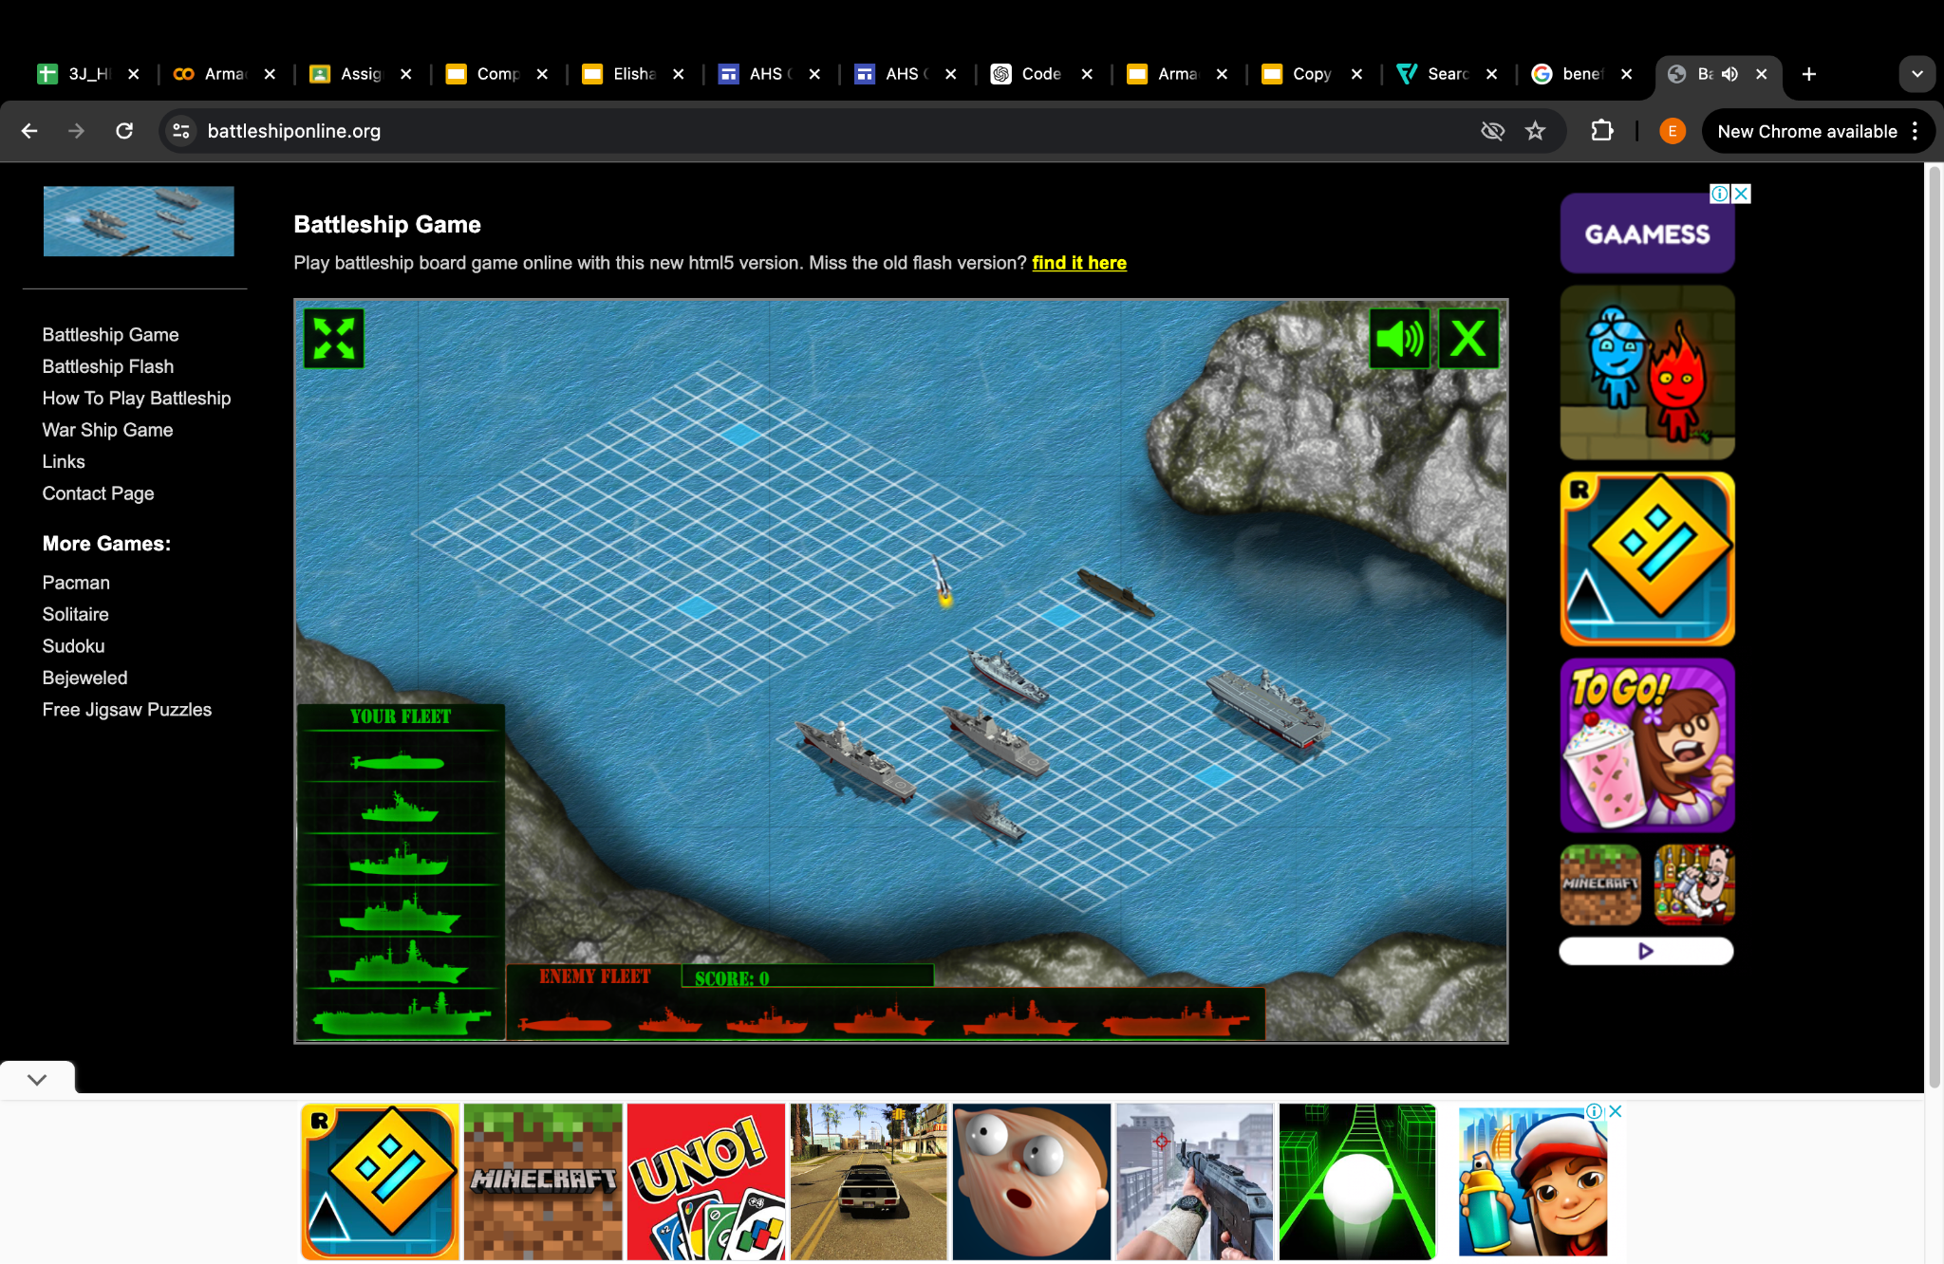
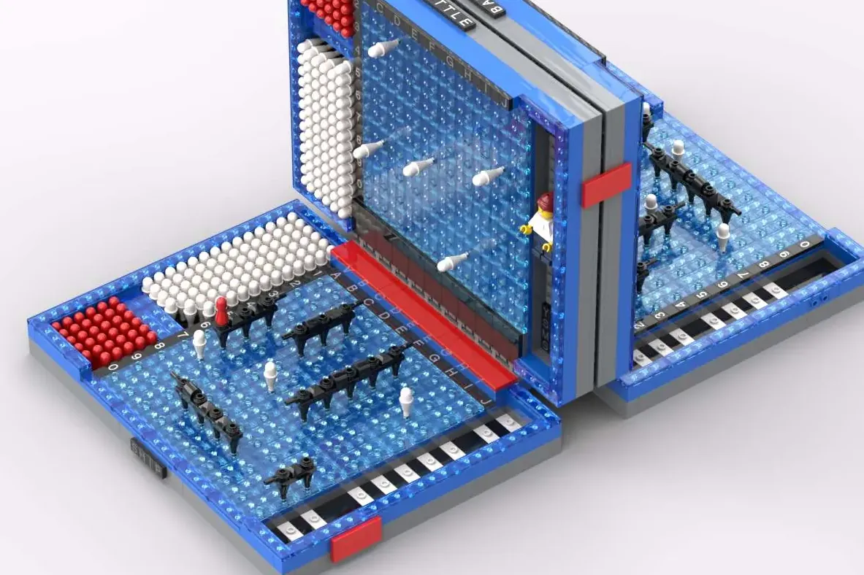
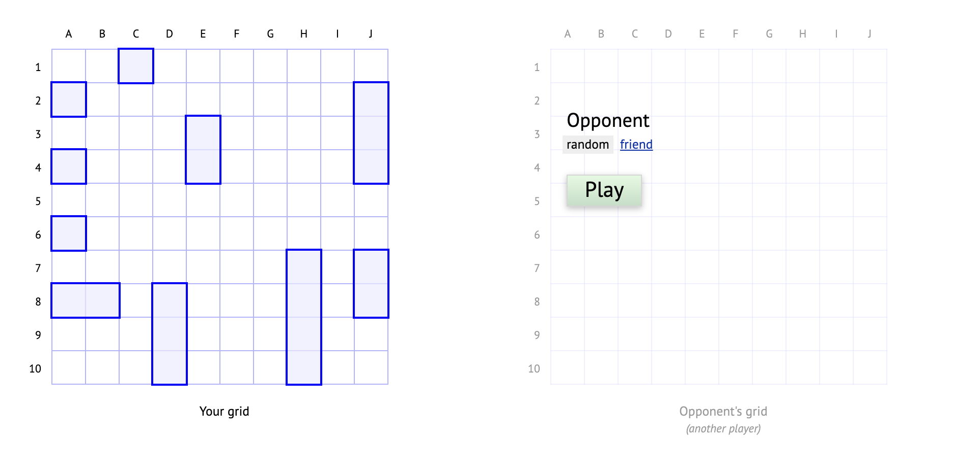
What is this game for?
As we move into a digital age, many of us are tired and bored of playing “old fashioned” board games. However, Armada is more attractive thanks to it being online, against a bot, much harder, plus special features! This makes Armada completely revamped and different from other battleship games in the market
Notes:
So maybe some of us remembered these versions of battleship we used to play while we were younger

Slide 5
-02-
Game Play
..
,z@%qu{^
:Q8@$@$@dj!
`_vq@$@$Z_.
.if> I/d@$@w_.
:M@@$#Y}' -d$@$LI
^nvw@@$@MJ~ {a@@M~.
'<J8@$%YI >p$@@?.
'l: ;c&$@q+ ^m$@$i
iJ$@$@@o1 _p$@d_ ,d@@#:
[n! -@$@&YZ$@@Q [h$@c, (#MJ,.
_q@$@LI 8@$M `|$$b+ n@&Z~
}h$@$@$@U: )$@@dnY@@@O'
_p@$Z_f#@$@X^.n@@$@$@@$Mn"
j@$8) "rM$@$@@$@x"{xf<
."` "n&$@$@'
`?i ,v%$@@r
i0@$L! :X@@$8f
)*@$m> :U@$@W|
r8@$@Zj: ^Y$@$$p
_q$@$@@$@$&aa&$@@$@#|
?b$@h#$@$B@@$@$@&UrI
}o$@m<]h@@*!
.)&@$0> +k@$8<
'/@@$CI Ib@$@?.
._zzXzXZ$@$oCzzXzzXJW@$$UzXzzc_
't@$@$@@$@@$@$$@$@$@$@$@$@$@$8f
"iii!iiiiiiii!iiiiiii!iiiiii!,

Slide 6

ROWS
COLUMNS
E.g. 4 <space> 0
You start the game by setting the coordinates of your ships on the board.
Receive an empty board
Players take turns guessing grid coordinates to find and sink each other's hidden ships. The first to sink all opponent ships wins.
Option to redeem special ability using resources earned after each turn.
If your ship sinks, so does their ability! (E.g. If Destroyer has sunk, you can’t use destroyer ability)
Type in coordinates separated by a space

Slide 7
Abilities can be used each round from the ships. Once the ship is dead, so is the ability!
Aircraft Carrier (A)
Missile Cruiser (M)
Radar (R)
Destroyer (D)
Submarine (S/U)
More:
{C|
M&$1.
"XB$$8|
.z$$$$o
fh$$$$$}
{f. Q8 _@$$$$$j.
~%n 'j$$$$$$$$$8j
]M$t L$$$$$$$$$x
!o$$_ .X$$$$$$$$$$$w
'@$$$$$$$$$$$$$$@f``''`'|$$$$$$$$$$$$%
lq$$$$$$$$$$$$$$$$$$$$$$$$$$$$$$$$$$Bb_
^0$$$$$$$$$$$$$$$$$$$$$$$$$$$$$$$$$$$/'
l "!#$$$$$$$$$$$$$$$$$$$$$$$$$$$$$$t.
}8$$$$$$$$$$$$$$$$$$$$$$$$$$x
(C@$$$$$$$$$$$$$$$$$$$$$$$n
r%$$$$$$$$$$$$$$$$$$$$$x
^q$$$$$$$$$$$$$$$$$$$o~
I8$$$$$$$$$$$$$$$$$$$[
?ftfffJ$$$$$$$$$$$$$$$$$$$$$$$$$]
r$$$$$$$$$$$$$$$$$O$$$$$$$$$$$$$$[
'`-$$$$$$$$$$$v. ,$$$$$$$$$$$$$$: +
>@$$$$$$$u io$$$$$$$$$$$$; ^+mk
b$Wm$$$$8| [W$$$$$$$$$$z@$di
c$$$O >@$$$$$$$$$$8i
w$$Z ]$$$$$$$B;
c@$O -*$$$M{
|( >a$)
r}.
$$$$$$
$$$$$$$$$$
$$$$$$ $$$$
$$$$$$ $$$$$
$$$$$ $$$$$
$$$$ $$$$
$$$$$$ $$$$
$$$$$ $$$$ $$$$
$$$$$$$$$$$$$$ $$$$$$$$
$$$$$$$$$$$$$$$ $$$$ $$$$$
$$$$$$ $$$$ $$$$ $$$$$
$$$$$$$$$ $$$$$ $$$$
$$$$$ $$$$$ $$$$
$$$$$ $$$$ $$$$$$
$$$$$$$ $$ $$$$$ $$
$$$$$$$$$ $$$$$ $$$$$ $$$
$$$$$$$$$$$$$ $$$$$$$$$$$ $$
$$$$$$ $$$$$ $$$$ $$$$ $$$ $$
$$$$$ $$$$$ $$$$ $$$$$ $$$$$
$$$$$$ $$$$ $$$$ $$$$$$
$$$$$$$$ $$$$$ $$$$$$$
$$$$ $$$$$ $$$$$$$$
$$$ $$$$ $$$$ $$$
$$$$$ $$$$ $$$$
$$$$$$$$ $$$$$ $$$
$$$$$$$$$$$$$$$ $$$$
$$$$ $$$$$$
$$$
..
,z@%qu{^
:Q8@$@$@dj!
`_vq@$@$Z_.
.if> I/d@$@w_.
:M@@$#Y}' -d$@$LI
^nvw@@$@MJ~ {a@@M~.
'<J8@$%YI >p$@@?.
'l: ;c&$@q+ ^m$@$i
iJ$@$@@o1 _p$@d_ ,d@@#:
[n! -@$@&YZ$@@Q [h$@c, (#MJ,.
_q@$@LI 8@$M `|$$b+ n@&Z~
}h$@$@$@U: )$@@dnY@@@O'
_p@$Z_f#@$@X^.n@@$@$@@$Mn"
j@$8) "rM$@$@@$@x"{xf<
."` "n&$@$@'
`?i ,v%$@@r
i0@$L! :X@@$8f
)*@$m> :U@$@W|
r8@$@Zj: ^Y$@$$p
_q$@$@@$@$&aa&$@@$@#|
?b$@h#$@$B@@$@$@&UrI
}o$@m<]h@@*!
.)&@$0> +k@$8<
'/@@$CI Ib@$@?.
._zzXzXZ$@$oCzzXzzXJW@$$UzXzzc_
't@$@$@@$@@$@$$@$@$@$@$@$@$@$8f
"iii!iiiiiiii!iiiiiii!iiiiii!,
Sends 5 fighter jets to shoot at random targets
Launches a missile that does area damage
Reveals an enemy position, with the option to shoot it down
. . . . . . . . . . . .. . . 0. . . . .. . . . . . . ..
. .. .. .. .. . . . . . . . .[aaaaaa.. . . . . . . . . . .
. . . . . . . . . .. .'ttOa~aaaaaaa~. . . . . . .. . . .
. . . . ..J. . . ... `llraacaaawphax . . . . . . . . . .
. . . . . .OZOZf.`CZwkhhdhaqhhwhphpbqwaaa~. .. . . .. . .
. . . UaaaaaaaaaaaaaUtt/t/t/t/t/t/t/ttt-tt . . . . . . .
.. ....'qaaaaaaaaaaaaaaaaaaaaaaaaaaaaaaaaaaaaaaaaaa^ . ..
. . . . . qaaaaaaaaaaaaaaaaaaaaaaaaaaaaaaaaaaaaaaaU . . .
. . . . ... IIIIIIIIIIIIIIIIIIIIIIIIIIIIIIIIIIIIII .. . .
.%
^. .B
l)jjfjBffu*[
f&$$$$$$$$$$q
z@$$$$$$$$$$q
;p$Y^ .>||||||/|||||/|||||w$$$$$$$$$$$o|||||||||||8|||(+
?a$$u'jrnq$$$$$$$$$$$$$$$$$$$$$$$$$$$$$$$$$$$$$$$$$$$$$$$$$$$$$$$*X]`
?a$$$$$$$$$$$$$$$$$$$$$$$$$$$$$$$$$$$$$$$$$$$$$$$$$$$$$$$$$$$$$$$$$$$(.
tu :Y8$$$$$$$$$$$$$$$$$$$$$$$$$$$$$$$$$$$$$$$$$$$$$$$$$$$$$$$$$$$$$$$$$$$@[
IJ0{{p$$$$$$$$$$$$$$$$$$$$$$$$$$$$$$$$$$$$$$$$$$$$$$$$$$$$$$$$$$$$$$$$$$$@t'
:I C@$$$[--1#@@$$@$$$$$$$$$$$$$$$$$$$$$$$$$$$$$$$$$$$$$$$$$$$$$$$$$@Z-i`
.l<<. :<<<<<<><<<<<<<<<<<<><<><<><><<><<<<<<<<`
_ _
/ \ _ __ _ __ ___ __ _ __| | __ _
/ _ \ | '__| '_ ` _ \ / _` |/ _` |/ _` |
/ ___ \| | | | | | | | (_| | (_| | (_| |
/_/ \_\_| |_| |_| |_|\__,_|\__,_|\__,_|
Shoots 3 more targets
Brings the submarine underwater to reduce the chance of being shot down!
To make the game harder, each ship is only takes up one space, instead of multiple spaces.

Slide 8
HOW TO WIN?
All your ships dead, enemy wins
All enemy ships dead, you win.
It’s not rocket science

Slide 9
-02-
Demo
..
,z@%qu{^
:Q8@$@$@dj!
`_vq@$@$Z_.
.if> I/d@$@w_.
:M@@$#Y}' -d$@$LI
^nvw@@$@MJ~ {a@@M~.
'<J8@$%YI >p$@@?.
'l: ;c&$@q+ ^m$@$i
iJ$@$@@o1 _p$@d_ ,d@@#:
[n! -@$@&YZ$@@Q [h$@c, (#MJ,.
_q@$@LI 8@$M `|$$b+ n@&Z~
}h$@$@$@U: )$@@dnY@@@O'
_p@$Z_f#@$@X^.n@@$@$@@$Mn"
j@$8) "rM$@$@@$@x"{xf<
."` "n&$@$@'
`?i ,v%$@@r
i0@$L! :X@@$8f
)*@$m> :U@$@W|
r8@$@Zj: ^Y$@$$p
_q$@$@@$@$&aa&$@@$@#|
?b$@h#$@$B@@$@$@&UrI
}o$@m<]h@@*!
.)&@$0> +k@$8<
'/@@$CI Ib@$@?.
._zzXzXZ$@$oCzzXzzXJW@$$UzXzzc_
't@$@$@@$@@$@$$@$@$@$@$@$@$@$8f
"iii!iiiiiiii!iiiiiii!iiiiii!,

Slide 10
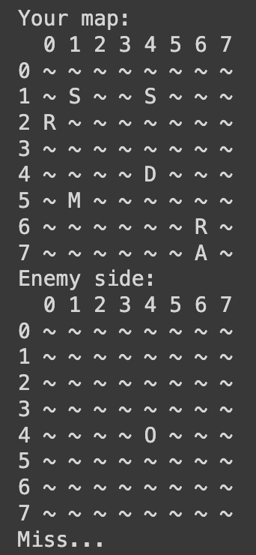
A missed guess

Slide 11
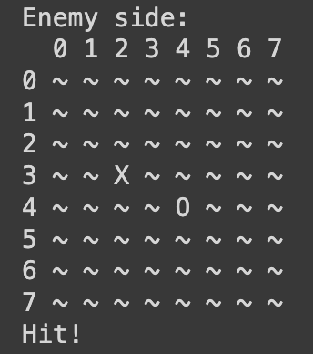
A correct guess

Slide 12
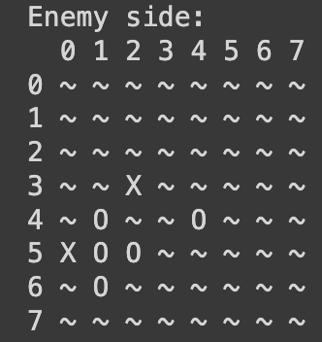
Using missile ability

Slide 13
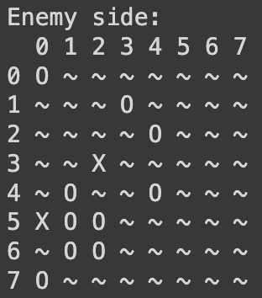
Using Aircraft Carrier ability

Slide 14
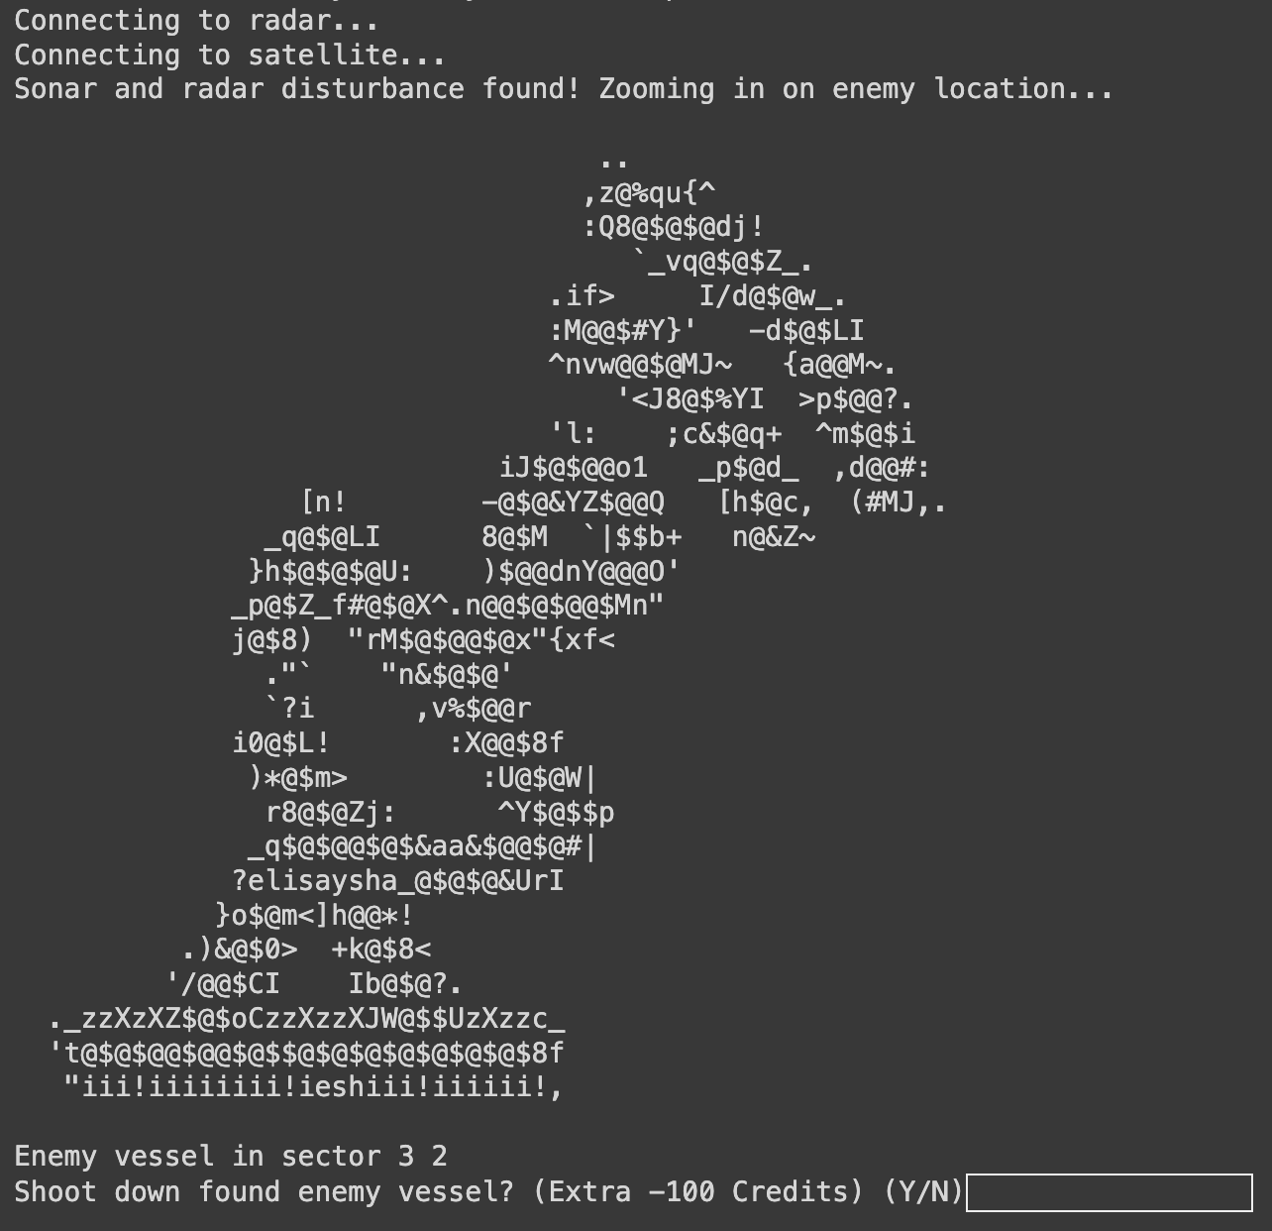
Using radar ability

Slide 15
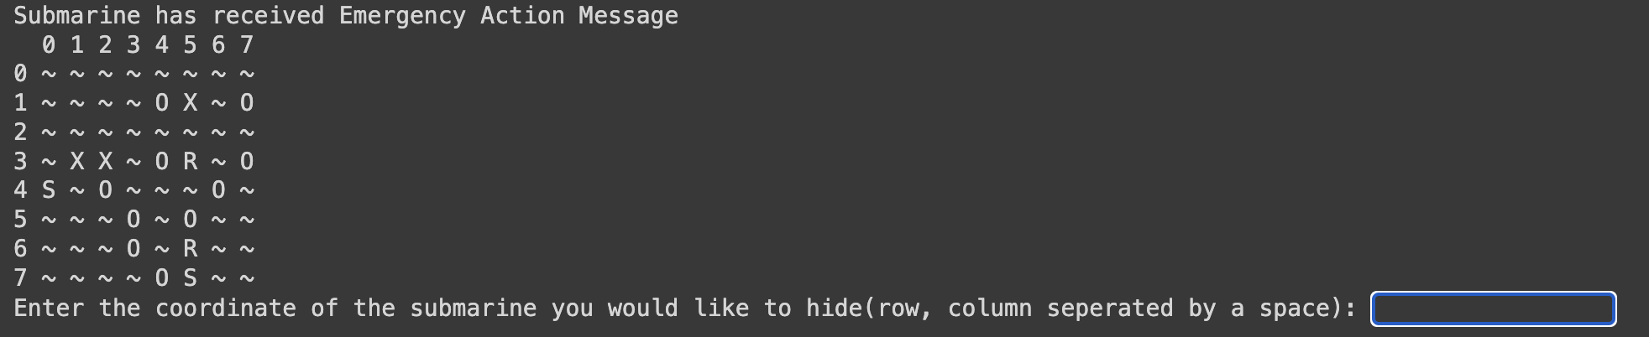
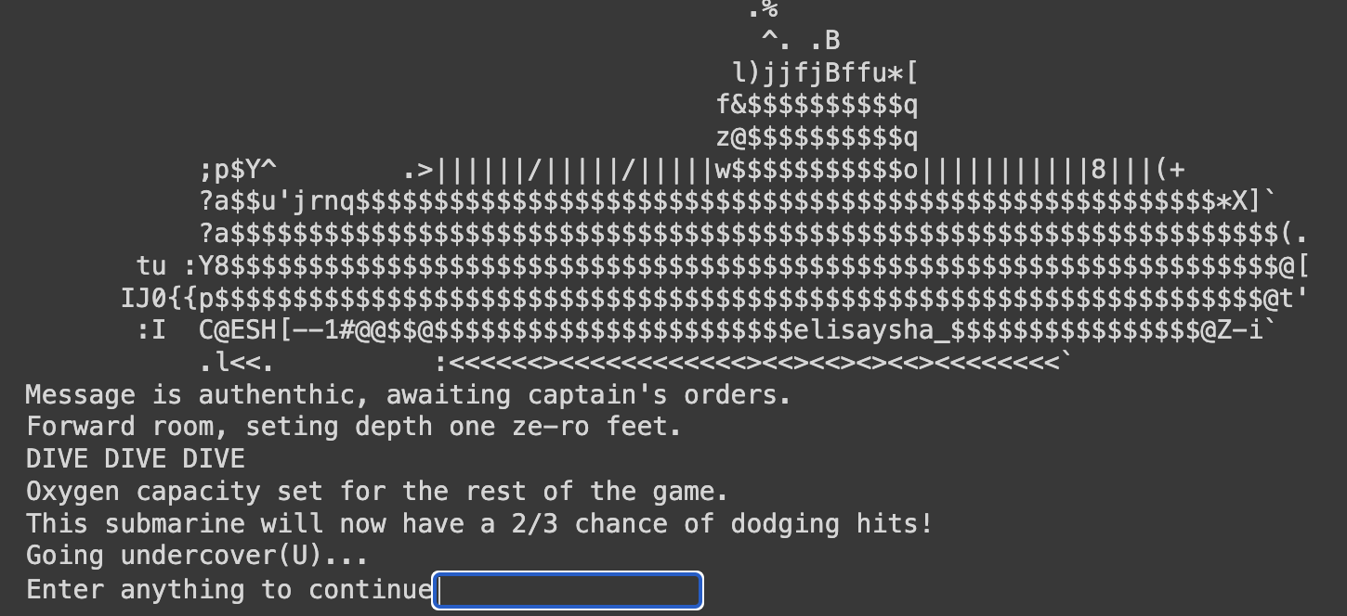
Using sub
ability

Slide 16
-03-
Code explanation
$$$$$$
$$$$$$$$$$
$$$$$$ $$$$
$$$$$$ $$$$$
$$$$$ $$$$$
$$$$ $$$$
$$$$$$ $$$$
$$$$$ $$$$ $$$$
$$$$$$$$$$$$$$ $$$$$$$$
$$$$$$$$$$$$$$$ $$$$ $$$$$
$$$$$$ $$$$ $$$$ $$$$$
$$$$$$$$$ $$$$$ $$$$
$$$$$ $$$$$ $$$$
$$$$$ $$$$ $$$$$$
$$$$$$$ $$ $$$$$ $$
$$$$$$$$$ $$$$$ $$$$$ $$$
$$$$$$$$$$$$$ $$$$$$$$$$$ $$
$$$$$$ $$$$$ $$$$ $$$$ $$$ $$
$$$$$ $$$$$ $$$$ $$$$$ $$$$$
$$$$$$ $$$$ $$$$ $$$$$$
$$$$$$$$ $$$$$ $$$$$$$
$$$$ $$$$$ $$$$$$$$
$$$ $$$$ $$$$ $$$
$$$$$ $$$$ $$$$
$$$$$$$$ $$$$$ $$$
$$$$$$$$$$$$$$$ $$$$
$$$$ $$$$$$
$$$

Slide 17
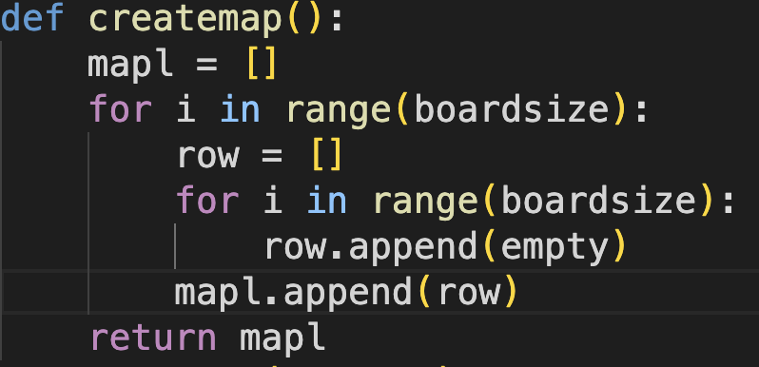

Let the size of the board to be 8
Adds 8 of the row list into a list
Creates a new list
Adds empty (“~”) to the “row” list 8 times
X8
…

Slide 18
0
Add “~” into list
1
Repeats 8 times
2
Repeats 8 times
3
4
0
1
2
3
4
5
Biglist [4]
[5]

Slide 19
-04-
Reflections
.%
^. .B
l)jjfjBffu*[
f&$$$$$$$$$$q
z@$$$$$$$$$$q
;p$Y^ .>||||||/|||||/|||||w$$$$$$$$$$$o|||||||||||8|||(+
?a$$u'jrnq$$$$$$$$$$$$$$$$$$$$$$$$$$$$$$$$$$$$$$$$$$$$$$$$$$$$$$$*X]`
?a$$$$$$$$$$$$$$$$$$$$$$$$$$$$$$$$$$$$$$$$$$$$$$$$$$$$$$$$$$$$$$$$$$$(.
tu :Y8$$$$$$$$$$$$$$$$$$$$$$$$$$$$$$$$$$$$$$$$$$$$$$$$$$$$$$$$$$$$$$$$$$$@[
IJ0{{p$$$$$$$$$$$$$$$$$$$$$$$$$$$$$$$$$$$$$$$$$$$$$$$$$$$$$$$$$$$$$$$$$$$@t'
:I C@$$$[--1#@@$$@$$$$$$$$$$$$$$$$$$$$$$$$$$$$$$$$$$$$$$$$$$$$$$$$$@Z-i`
.l<<. :<<<<<<><<<<<<<<<<<<><<><<><><<><<<<<<<<`

Slide 20


The Good Stuff
The not so good stuff
The game’s design can be completely refreshed thanks to the use of variables, opening up for future updates!
The game is fun and engaging with lots of positive feedback!
The bugs in the code are very minimal thanks to many sleepless nights
The code is very complicated and not so easy to read. Despite many many comments and trying to cut short code, it still has over 700 lines!

Slide 21
Future plans…
Armada
AI Enemy
Graphics
Feedback
Platforms
The current bot enemy is using randint to strike. An AI bot that studies patterns would be cool
As of now, Armada is just text-based. Wouldn’t it be more interesting if there were graphics?
Armada is still beta, meaning the game is still open for updates!
Imagine Armada in platforms like Discord, Roblox or on your mobile phone!

Slide 22
TANKS
80+ hours spent, 2000+ times code was run, 730++ lines of code
_ _
/ \ _ __ _ __ ___ __ _ __| | __ _
/ _ \ | '__| '_ ` _ \ / _` |/ _` |/ _` |
/ ___ \| | | | | | | | (_| | (_| | (_| |
/_/ \_\_| |_| |_| |_|\__,_|\__,_|\__,_|
{C|
M&$1.
"XB$$8|
.z$$$$o
fh$$$$$}
{f. Q8 _@$$$$$j.
~%n 'j$$$$$$$$$8j
]M$t L$$$$$$$$$x
!o$$_ .X$$$$$$$$$$$w
'@$$$$$$$$$$$$$$@f``''`'|$$$$$$$$$$$$%
lq$$$$$$$$$$$$$$$$$$$$$$$$$$$$$$$$$$Bb_
^0$$$$$$$$$$$$$$$$$$$$$$$$$$$$$$$$$$$/'
l "!#$$$$$$$$$$$$$$$$$$$$$$$$$$$$$$t.
}8$$$$$$$$$$$$$$$$$$$$$$$$$$x
(C@$$$$$$$$$$$$$$$$$$$$$$$n
r%$$$$$$$$$$$$$$$$$$$$$x
^q$$$$$$$$$$$$$$$$$$$o~
I8$$$$$$$$$$$$$$$$$$$[
?ftfffJ$$$$$$$$$$$$$$$$$$$$$$$$$]
r$$$$$$$$$$$$$$$$$O$$$$$$$$$$$$$$[
'`-$$$$$$$$$$$v. ,$$$$$$$$$$$$$$: +
>@$$$$$$$u io$$$$$$$$$$$$; ^+mk
b$Wm$$$$8| [W$$$$$$$$$$z@$di
c$$$O >@$$$$$$$$$$8i
w$$Z ]$$$$$$$B;
c@$O -*$$$M{
|( >a$)
r}.
..
,z@%qu{^
:Q8@$@$@dj!
`_vq@$@$Z_.
.if> I/d@$@w_.
:M@@$#Y}' -d$@$LI
^nvw@@$@MJ~ {a@@M~.
'<J8@$%YI >p$@@?.
'l: ;c&$@q+ ^m$@$i
iJ$@$@@o1 _p$@d_ ,d@@#:
[n! -@$@&YZ$@@Q [h$@c, (#MJ,.
_q@$@LI 8@$M `|$$b+ n@&Z~
}h$@$@$@U: )$@@dnY@@@O'
_p@$Z_f#@$@X^.n@@$@$@@$Mn"
j@$8) "rM$@$@@$@x"{xf<
."` "n&$@$@'
`?i ,v%$@@r
i0@$L! :X@@$8f
)*@$m> :U@$@W|
r8@$@Zj: ^Y$@$$p
_q$@$@@$@$&aa&$@@$@#|
?b$@h#$@$B@@$@$@&UrI
}o$@m<]h@@*!
.)&@$0> +k@$8<
'/@@$CI Ib@$@?.
._zzXzXZ$@$oCzzXzzXJW@$$UzXzzc_
't@$@$@@$@@$@$$@$@$@$@$@$@$@$8f
"iii!iiiiiiii!iiiiiii!iiiiii!,
$$$$$$
$$$$$$$$$$
$$$$$$ $$$$
$$$$$$ $$$$$
$$$$$ $$$$$
$$$$ $$$$
$$$$$$ $$$$
$$$$$ $$$$ $$$$
$$$$$$$$$$$$$$ $$$$$$$$
$$$$$$$$$$$$$$$ $$$$ $$$$$
$$$$$$ $$$$ $$$$ $$$$$
$$$$$$$$$ $$$$$ $$$$
$$$$$ $$$$$ $$$$
$$$$$ $$$$ $$$$$$
$$$$$$$ $$ $$$$$ $$
$$$$$$$$$ $$$$$ $$$$$ $$$
$$$$$$$$$$$$$ $$$$$$$$$$$ $$
$$$$$$ $$$$$ $$$$ $$$$ $$$ $$
$$$$$ $$$$$ $$$$ $$$$$ $$$$$
$$$$$$ $$$$ $$$$ $$$$$$
$$$$$$$$ $$$$$ $$$$$$$
$$$$ $$$$$ $$$$$$$$
$$$ $$$$ $$$$ $$$
$$$$$ $$$$ $$$$
$$$$$$$$ $$$$$ $$$
$$$$$$$$$$$$$$$ $$$$
$$$$ $$$$$$
$$$
.%
^. .B
l)jjfjBffu*[
f&$$$$$$$$$$q
z@$$$$$$$$$$q
;p$Y^ .>||||||/|||||/|||||w$$$$$$$$$$$o|||||||||||8|||(+
?a$$u'jrnq$$$$$$$$$$$$$$$$$$$$$$$$$$$$$$$$$$$$$$$$$$$$$$$$$$$$$$$*X]`
?a$$$$$$$$$$$$$$$$$$$$$$$$$$$$$$$$$$$$$$$$$$$$$$$$$$$$$$$$$$$$$$$$$$$(.
tu :Y8$$$$$$$$$$$$$$$$$$$$$$$$$$$$$$$$$$$$$$$$$$$$$$$$$$$$$$$$$$$$$$$$$$$@[
IJ0{{p$$$$$$$$$$$$$$$$$$$$$$$$$$$$$$$$$$$$$$$$$$$$$$$$$$$$$$$$$$$$$$$$$$$@t'
:I C@$$$[--1#@@$$@$$$$$$$$$$$$$$$$$$$$$$$$$$$$$$$$$$$$$$$$$$$$$$$$$@Z-i`
.l<<. :<<<<<<><<<<<<<<<<<<><<><<><><<><<<<<<<<`
My teachers: Mr Shahid and Mdm Ng
and the beta testers
. . . . . . . . . . . .. . . 0. . . . .. . . . . . . ..
. .. .. .. .. . . . . . . . .[aaaaaa.. . . . . . . . . . .
. . . . . . . . . .. .'ttOa~aaaaaaa~. . . . . . .. . . .
. . . . ..J. . . ... `llraacaaawphax . . . . . . . . . .
. . . . . .OZOZf.`CZwkhhdhaqhhwhphpbqwaaa~. .. . . .. . .
. . . UaaaaaaaaaaaaaUtt/t/t/t/t/t/t/ttt-tt . . . . . . .
.. ....'qaaaaaaaaaaaaaaaaaaaaaaaaaaaaaaaaaaaaaaaaaa^ . ..
. . . . . qaaaaaaaaaaaaaaaaaaaaaaaaaaaaaaaaaaaaaaaU . . .
. . . . ... IIIIIIIIIIIIIIIIIIIIIIIIIIIIIIIIIIIIII .. . .

